Slide 1
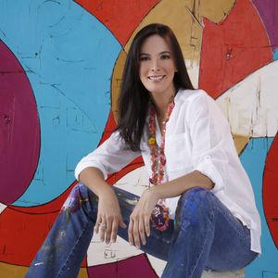
Giselle Borras
28 Place des Vosges | 75003, Paris
T + 33 1 42 76 94 93 | E paris@markhachem.com | W www.markhachem.com

Slide 2
BIOGRAPHY
28 Place des Vosges | 75003, Paris
T + 33 1 42 76 94 93 | E paris@markhachem.com | W www.markhachem.com

Slide 3
BIOGRAPHY
Giselle Borrás is a Colombian born artist who has lived and worked in Colombia, Spain and the United States of America. She has had several group and solo shows, and her work can be found in private collections across the United States and Colombia. She studied painting, drawing and color theory with several artists in Colombia and then continued her development in Madrid, Spain at The Fuencarral Studio. For the past twelve years she has been committed to her artistic work drawing inspiration from her continuous admiration for the human body.
The end results of her work are these subtle and weightless figures, created from maintaining the painting process spontaneous, filled with innocence and yet providing the viewer much force, energy and presence. Her colors remain consistent, always vibrant and bold, and the painting is finished when the idea has become a complete discussion. Art is a language spoken with fluency by this up and coming artist.
Her work reflects on the concept of reality as a mental construct by presenting metaphors that suggest that there is no reality other than our perception. The artist appropriates public spaces to become intimate, representing a personal experience in a static moment.

Slide 4
EXHIBITIONS
28 Place des Vosges | 75003, Paris
T + 33 1 42 76 94 93 | E paris@markhachem.com | W www.markhachem.com

Slide 5
SOLO EXHIBITIONS
2021
(OPEN STUDIO). Fundazione Viafarini. Milano, Italy.
TRÁNSITO ESPIRAL. Galería Otros 360 Grados. Bogotá, Colombia.
2020
LA DESAPARICIÓN DEL SUEÑO. Galería Otros 360 Grados. Bogotá, Colombia.
2019
11 ONCE. Viloria Blanco Galería. Maracaibo, Venezuela.
2018
MOVIMIENTO EN LA PLÁSTICA DEL CARIBE. Galería Plaza de la Paz. Barranquilla, Colombia.
2017
LA MADRIGUERA DEL CONEJO. Fundación Casa Gases del Caribe. Barranquilla, Colombia.
PLURALIDADES Y CONFLICTOS EN LOS BORDES DE LO DIVERSO. La Escuela Galería. Barranquilla, Colombia.
2016
LO FUNDAMENTAL. Museo del Atlántico. Barranquilla, Colombia.
2015
LÍNEAS EN EL TIEMPO. La Escuela Galería. Barranquilla, Colombia.
SÍLFIDES. Giselle Borrás Galería. Barranquilla, Colombia.
2009
SUTILES E INGRÁVIDOS. Club ABC. Barranquilla, Colombia.
2006
INSTINTOS TRIBALES. Galería Cano. Cartagena, Colombia.
2005
DROP IN TO THE GROUND. Missura Studio. Coral Gables, USA.
2004
ART WALK. The Gallery. Beaufort, USA.

Slide 6
GROUP EXHIBITIONS
2020
DIÁLOGOS ENTRE OBRAS, Galería Otros 360 Grados. Bogotá, Colombia.
2019
GRAN COLECTIVA, Galería Otros 360 Grados. Bogotá, Colombia.
2018
MOVIMIENTO EN LA PLÁSTICA DEL CARIBE. Galería Plaza de la Paz. Barranquilla, Colombia.
2015
LÍNEAS EN EL TIEMPO. La Escuela Galería. Barranquilla, Colombia.
SÍLFIDES. Giselle Borrás Galería. Barranquilla, Colombia.
2009
SUTILES E INGRÁVIDOS. Club ABC. Barranquilla, Colombia.
2006
INSTINTOS TRIBALES. Galería Cano. Cartagena, Colombia.

Slide 7
ART FAIRS
2023
Palm Beach Modern + Contemporary | Mark Hachem Gallery | Palm Beach, USA.
Zona Maco | Mark Hachem Gallery | Ciudad de México, México.
2022
Estampa Contemporary Art Fair | Galería Otros 360 Grados | Madrid, España
Contemporary Istanbul | Mark Hachem Gallery | Istanbul, Turquía.
Zona Maco | Mark Hachem Gallery | Ciudad de México, México.
2021
Art Fair SIE7E-5INCO | Elsa Piñeres Galería | Barranquilla, Colombia.
2020
ARTBO | Galería Otros 360 Grados | Bogotá, Colombia.
BARCÚ | Galería Alejandra Calderón | Bogotá, Colombia.
Art Fair SIE7E-5INCO | Elsa Piñeres Galería | Barranquilla, Colombia.
2019
Art Fair SIE7E-5INCO | Elsa Piñeres Galería | Barranquilla, Colombia.
CARRÉ LATÍN | Palais Royal. París, France | (Invitada a participar en su 5ta edición; evento cancelado
por fuerza mayor).
2018
Spectrum Wynwood Art Miami | Fine Arts Initiatives | Miami, USA.

Slide 8
AVAILABLE ARTWORKS
28 Place des Vosges | 75003, Paris
T + 33 1 42 76 94 93 | E paris@markhachem.com | W www.markhachem.com

Slide 9
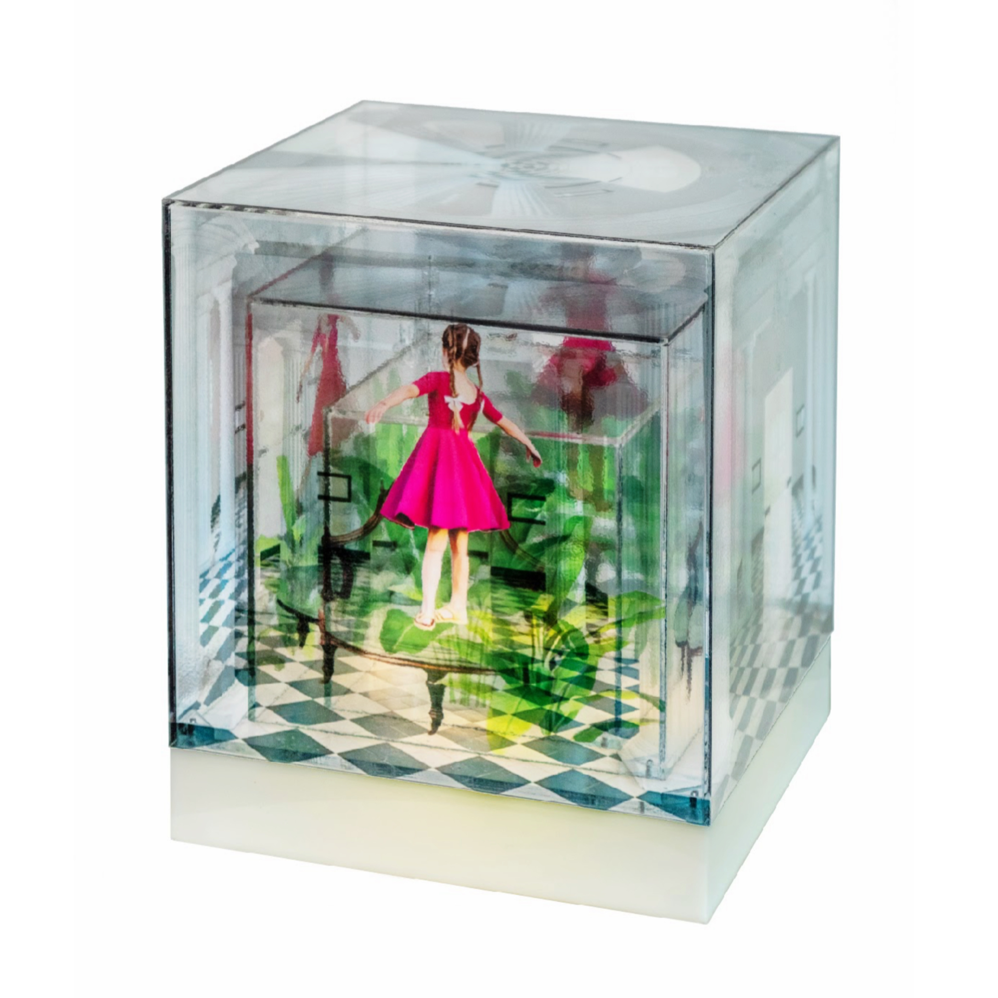
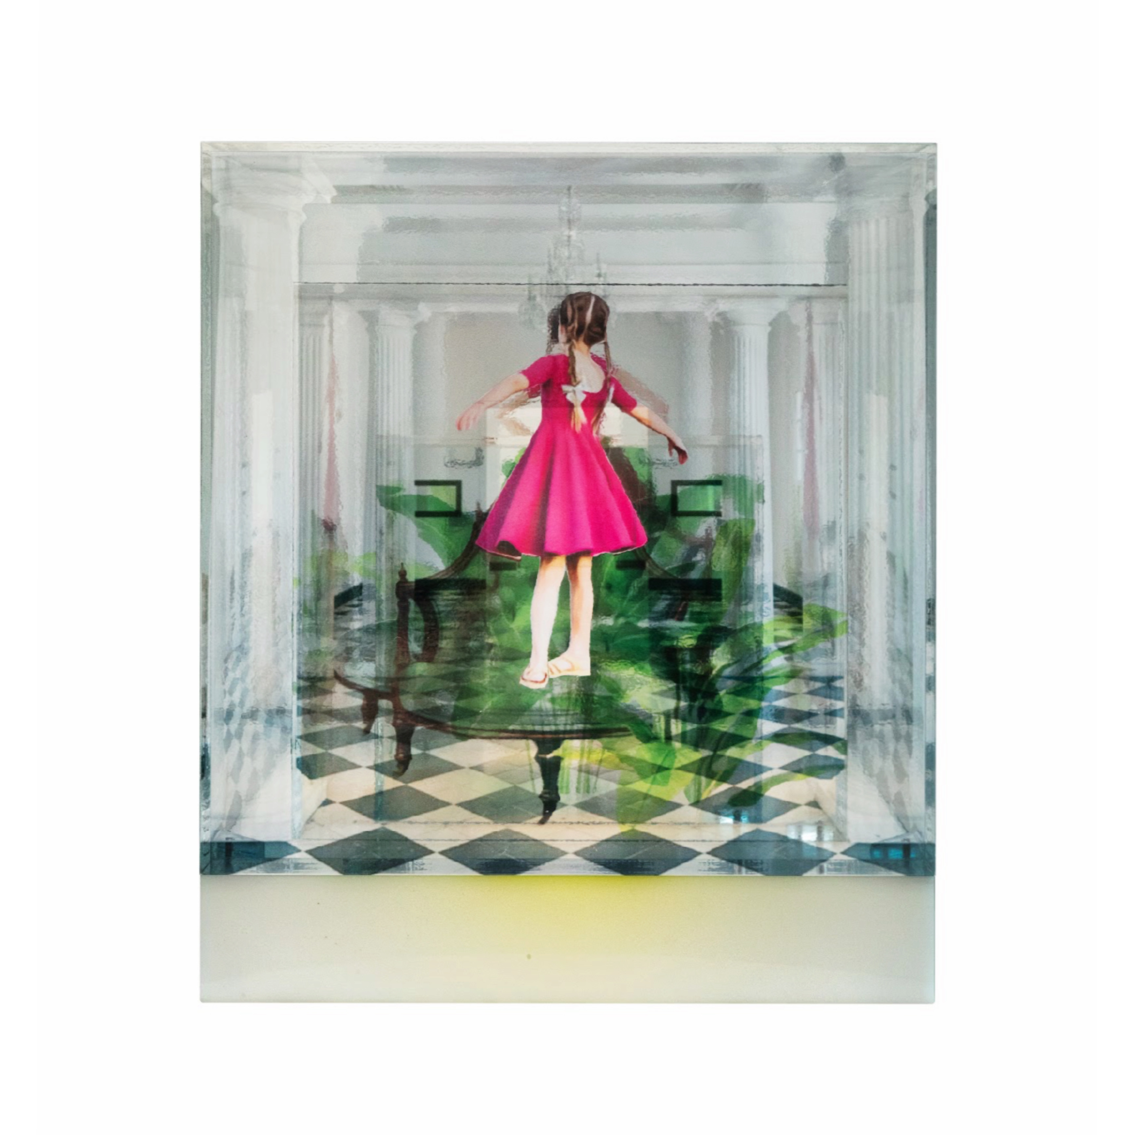
Giselle Borras
Habitaculos 1, 2023
Ensamble, photography, 3D collage, plexiglass, led light
28 x23 x 23 cm
AS
28 Place des Vosges | 75003, Paris
T + 33 1 42 76 94 93 | E paris@markhachem.com | W www.markhachem.com

Slide 10
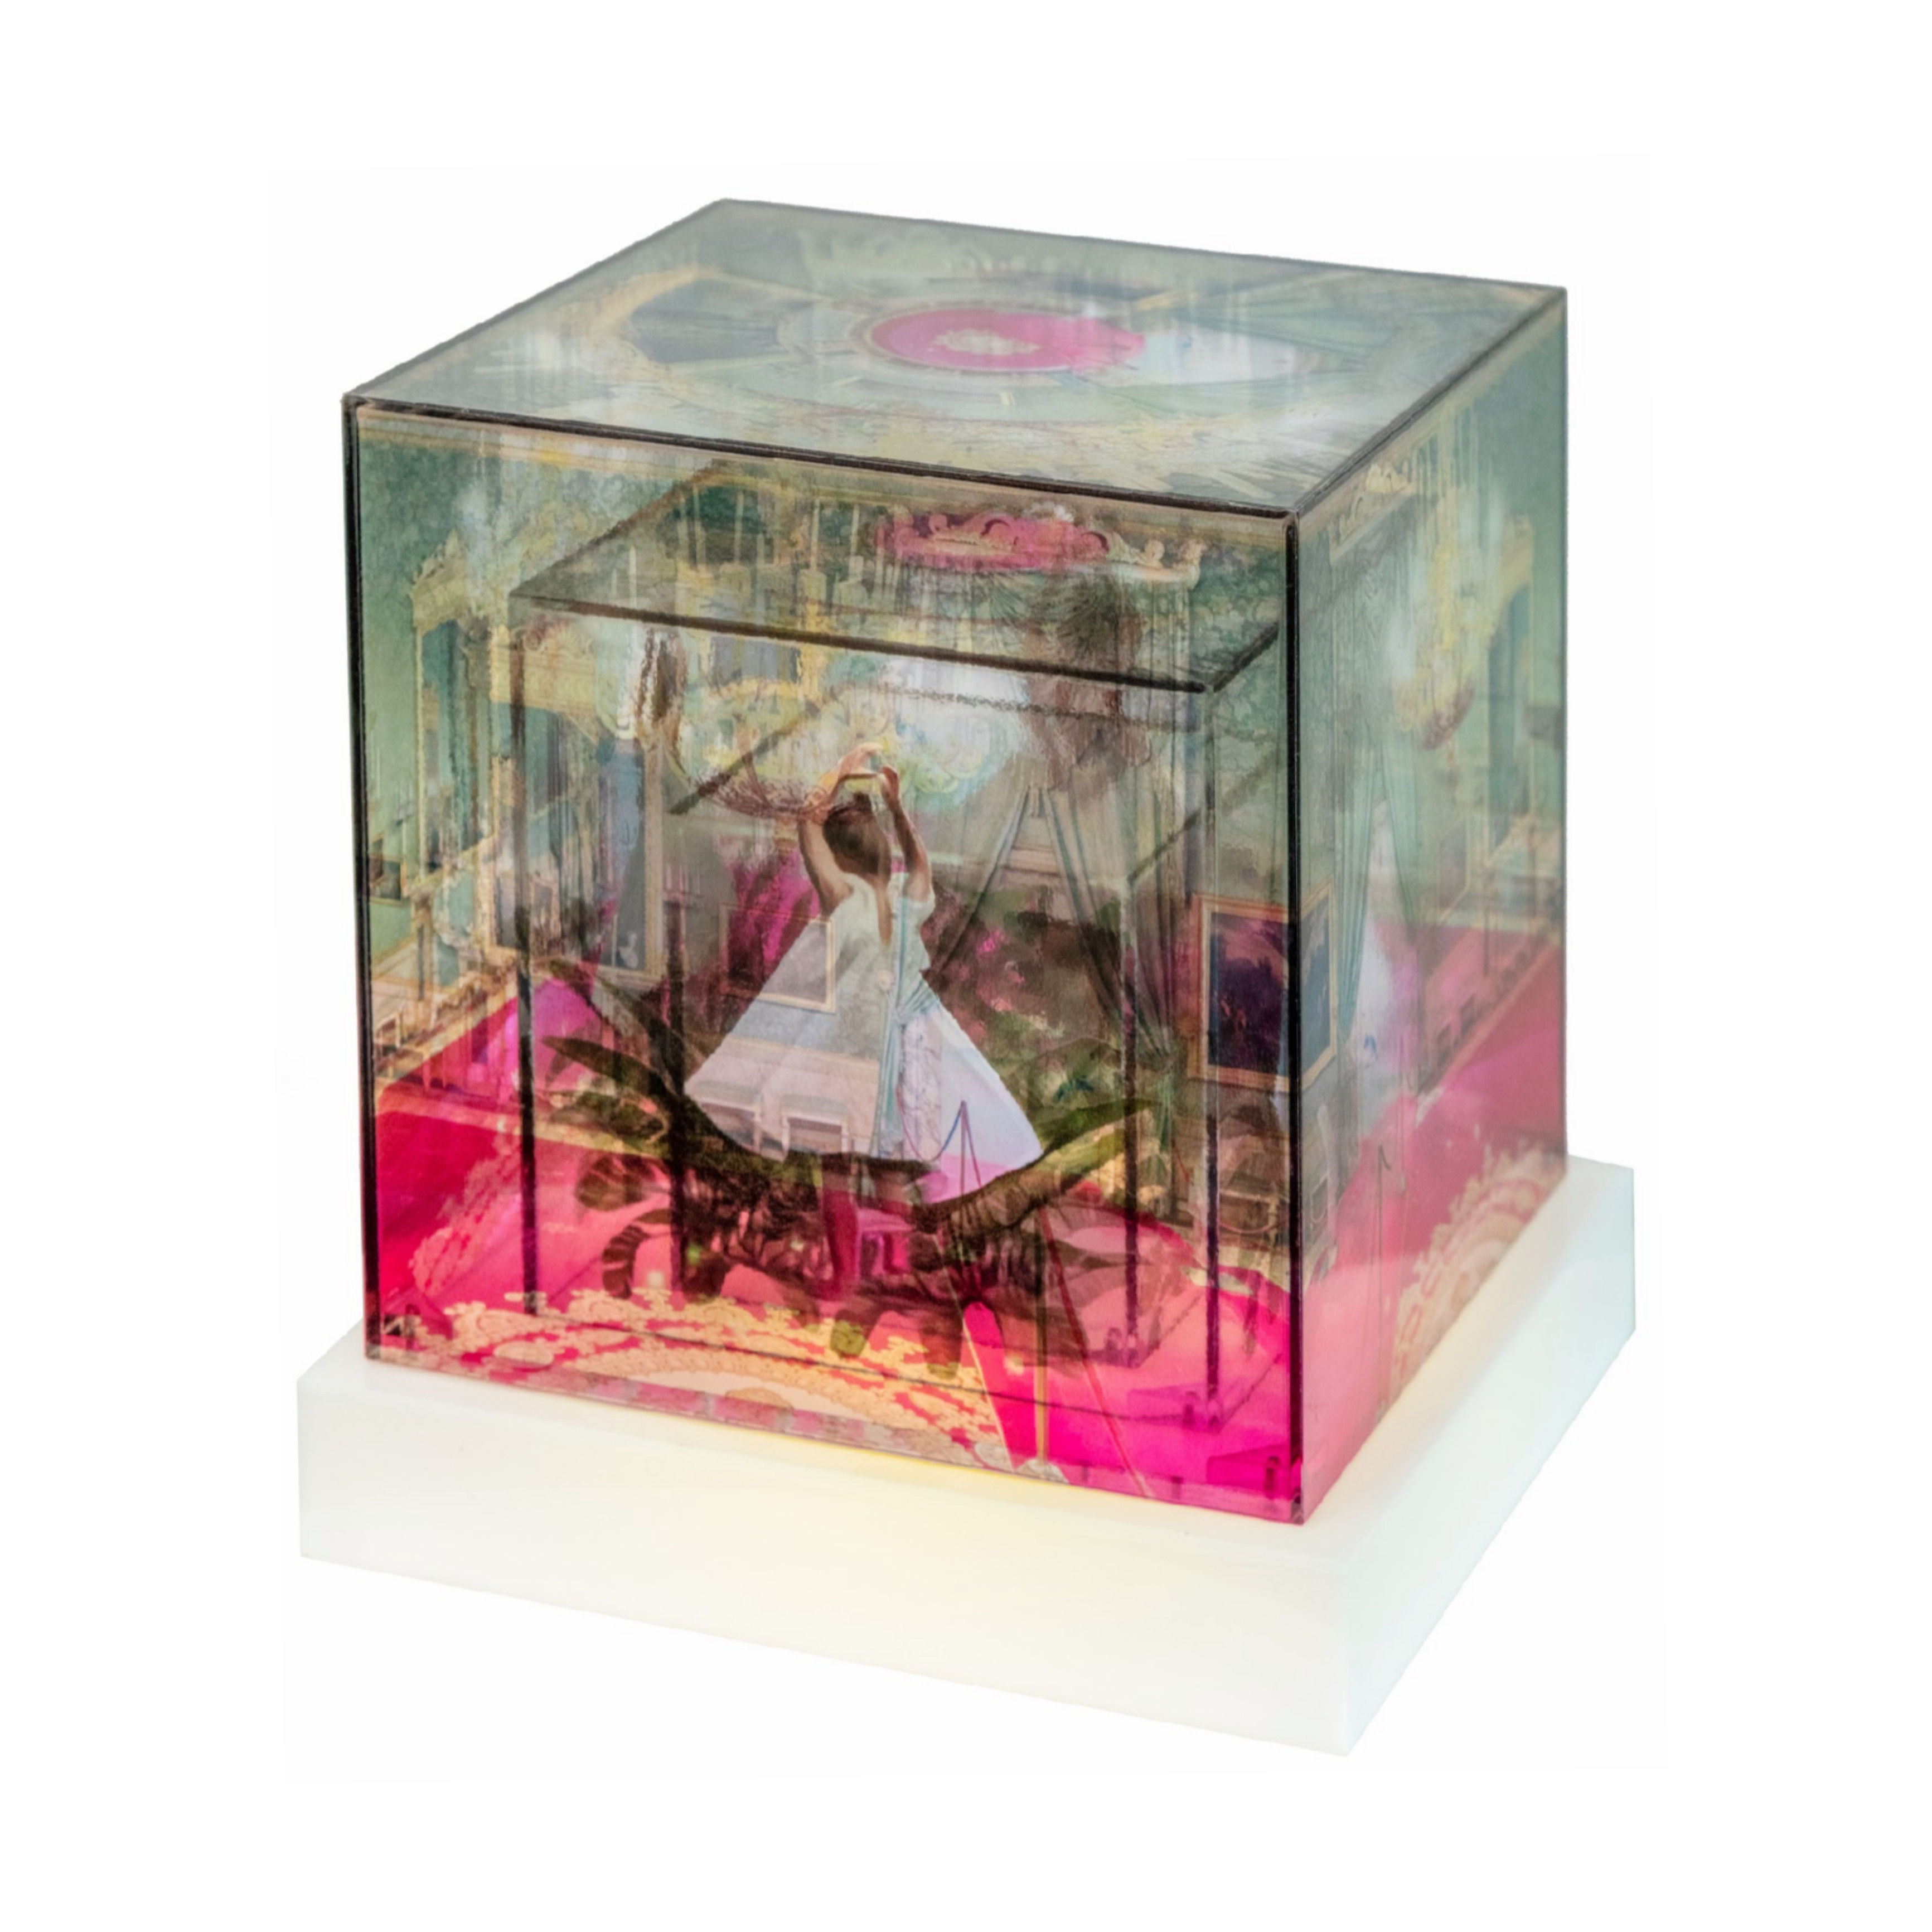
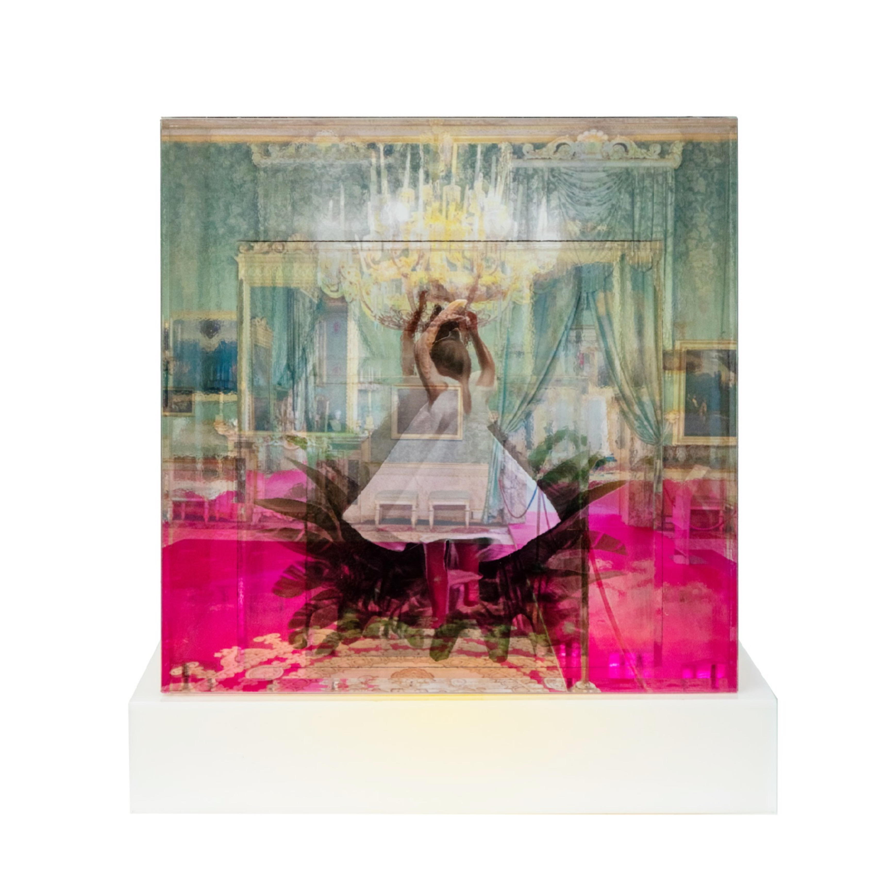
Giselle Borras
Habitaculos 2, 2023
Ensamble, photography, 3D collage, plexiglass, led light
25cm x 23cm x 23cm
AS
28 Place des Vosges | 75003, Paris
T + 33 1 42 76 94 93 | E paris@markhachem.com | W www.markhachem.com

Slide 11
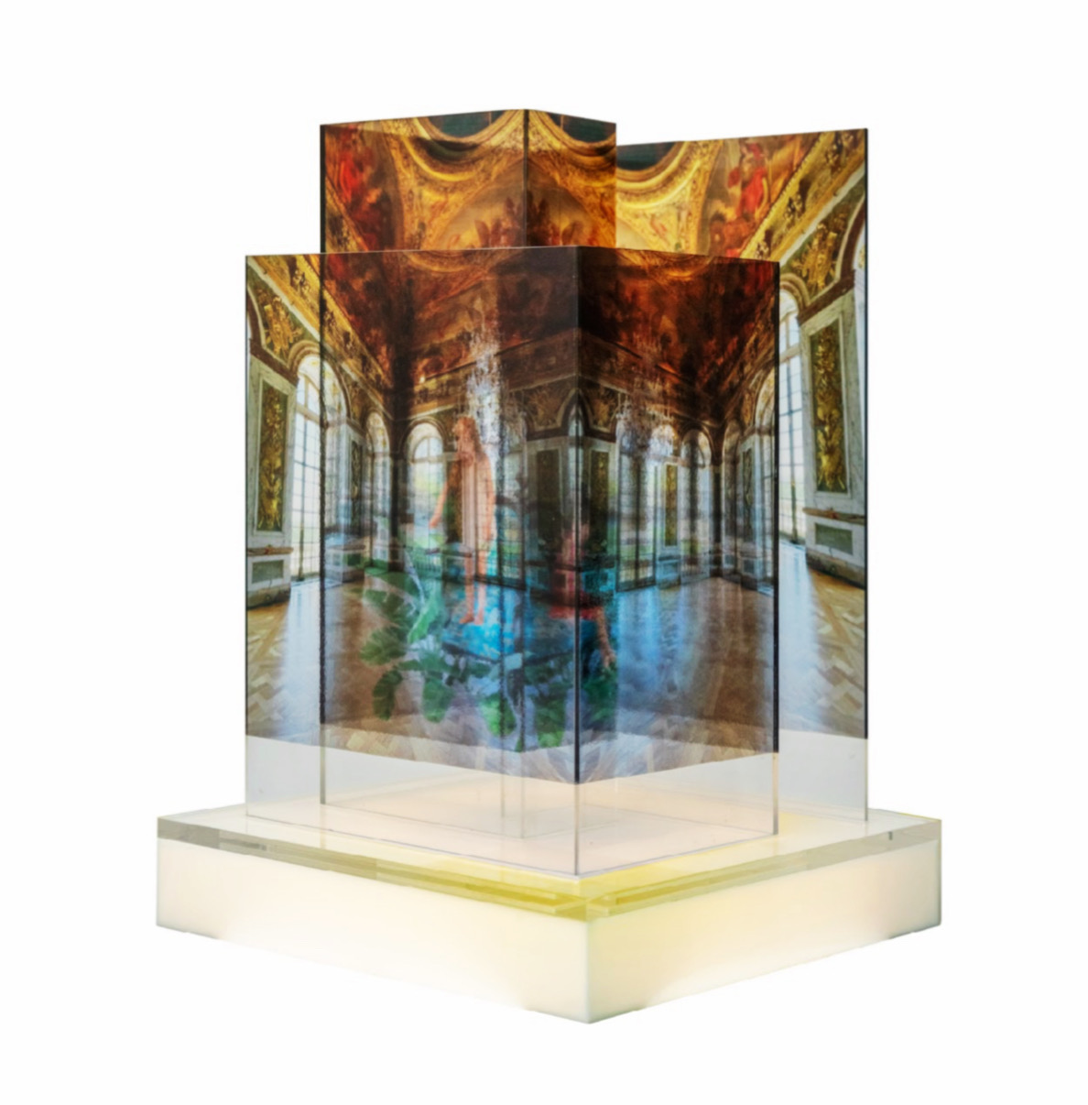
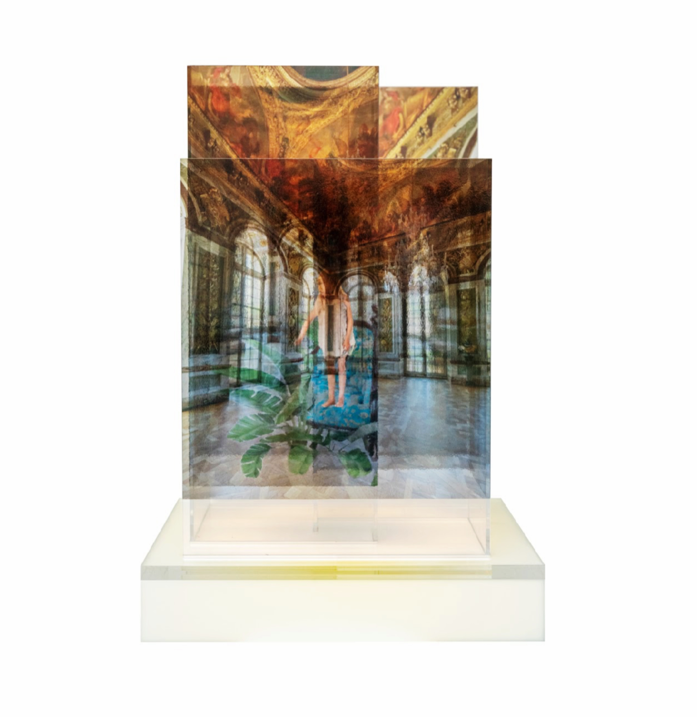
Giselle Borras
Labyrinth, 2023
Ensamble, photography, 3D collage, plexiglass, led light
45cm x 32cm x 32cm
AS
28 Place des Vosges | 75003, Paris
T + 33 1 42 76 94 93 | E paris@markhachem.com | W www.markhachem.com

Slide 12
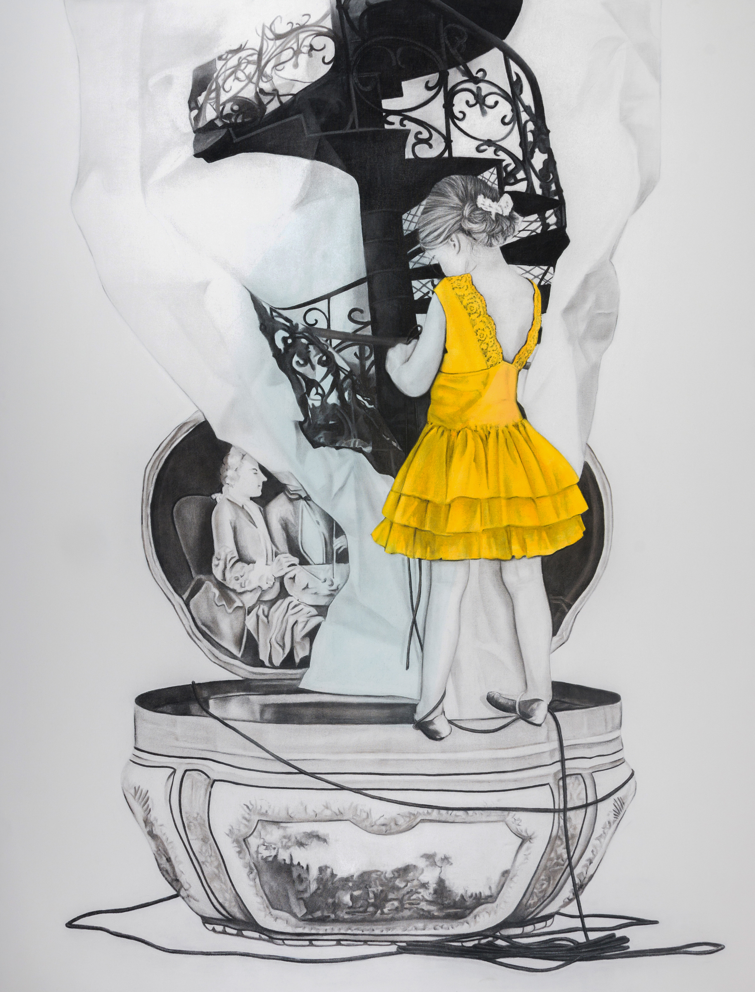
Giselle Borras
Mental Staircase, 2023
Charcoal drawing on canvas
170 x 130 cm
AS
28 Place des Vosges | 75003, Paris
T + 33 1 42 76 94 93 | E paris@markhachem.com | W www.markhachem.com

Slide 13
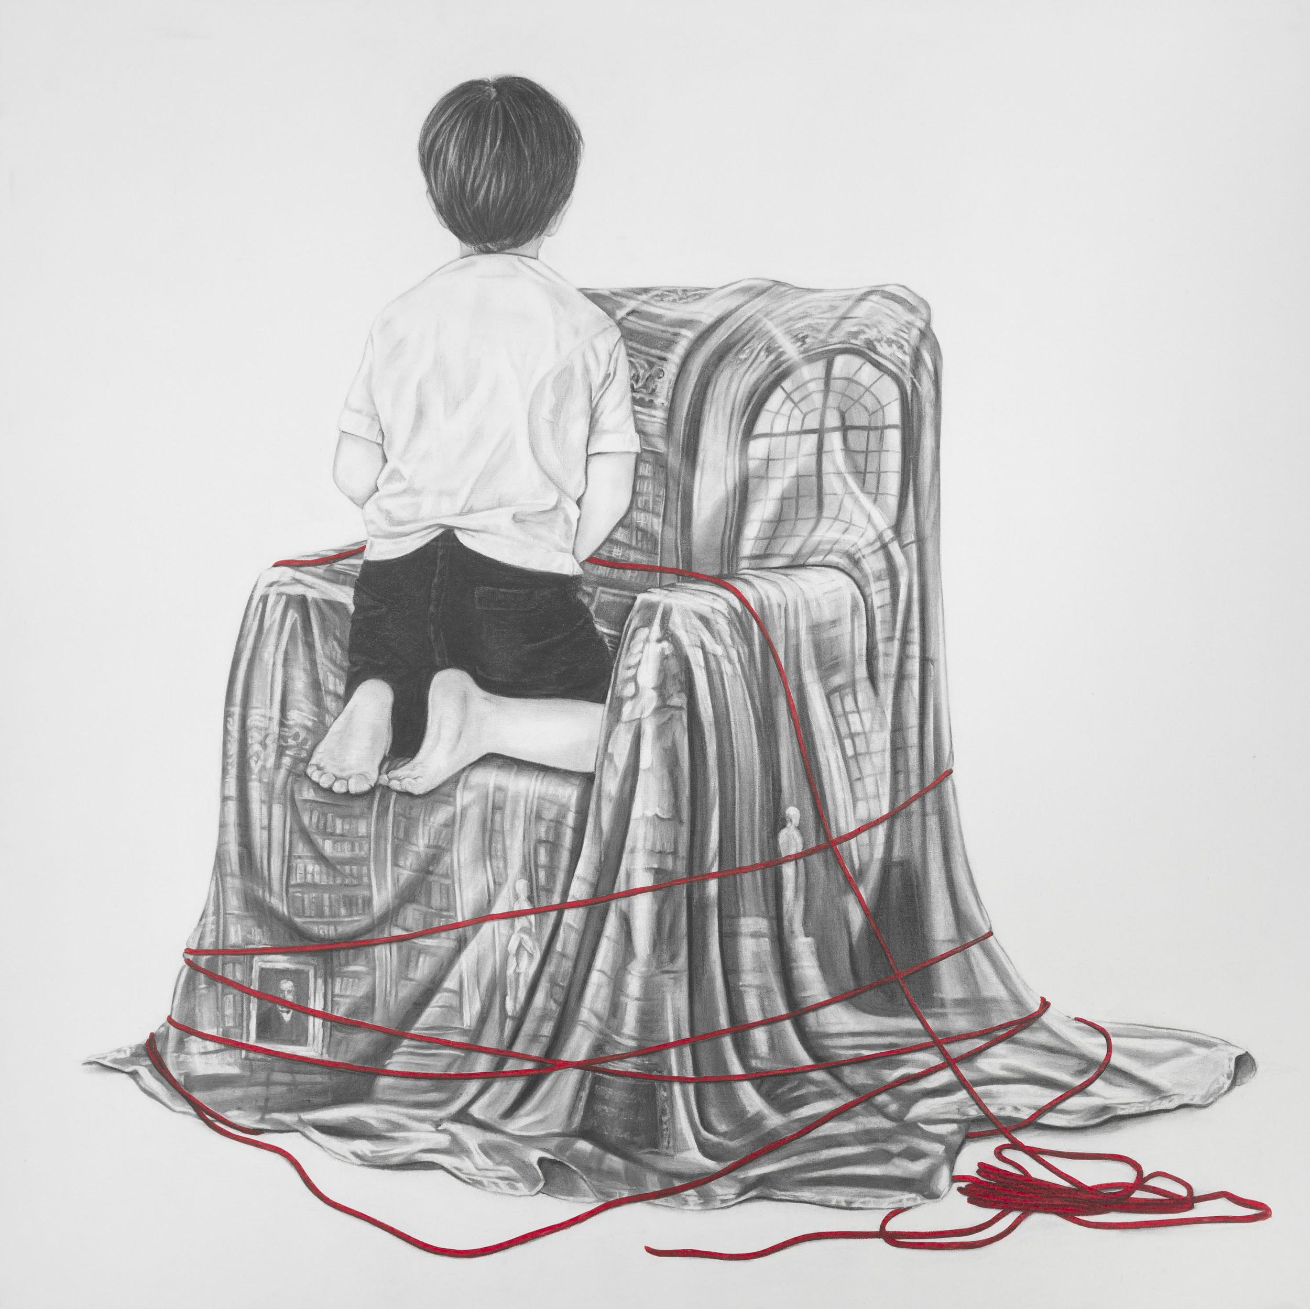
Giselle Borras
Mental Chair,2022
Charcoal drawing on canvas
120 x 120 cm
AS
28 Place des Vosges | 75003, Paris
T + 33 1 42 76 94 93 | E paris@markhachem.com | W www.markhachem.com

Slide 14
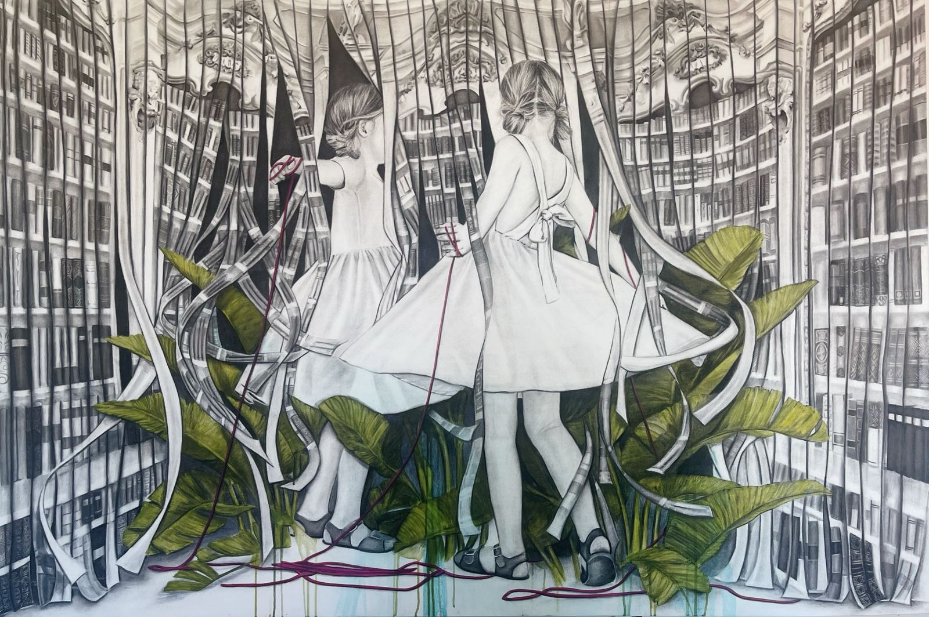
Giselle Borras
The spiral dance, 2023
Charcoal drawing on canvas
180 x 120 cm
AS
28 Place des Vosges | 75003, Paris
T + 33 1 42 76 94 93 | E paris@markhachem.com | W www.markhachem.com

